Slide 1
Standard form
Addition & Subtraction

Slide 2
What is standard form?
2(x+3y)
-5
2.78x10
y=mx+c
$$a^{2}+b^{2}=c^{2}$$
3
7.59x10
2
V=πr h

Slide 3
Why do we use it
42,000,000,000,000,000,000
42 Quintillion

Slide 4
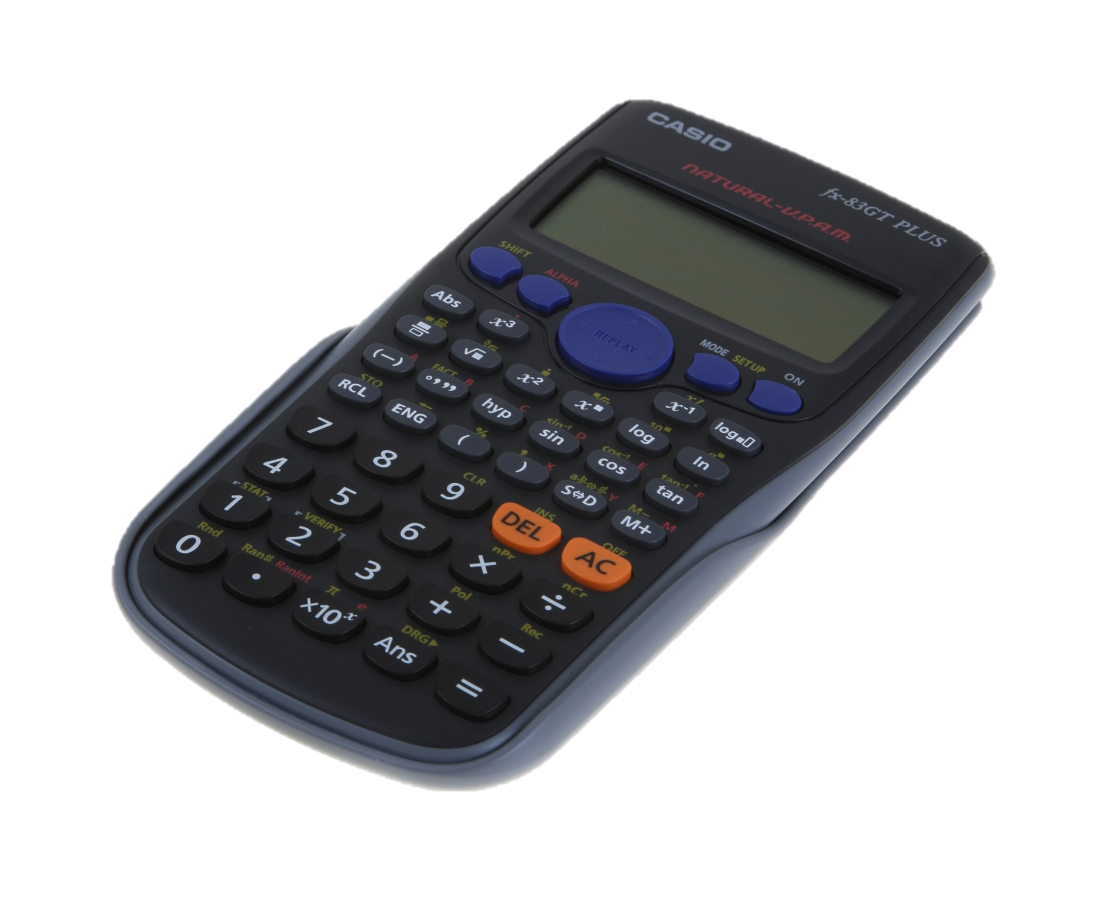
Why Do We use It
&#*?!@
42,000,000,
0
0
0

Slide 5
Basics of standard form
Count the number of 0’s at the end of the number OR after the decimal point (18)
Using 42 Quintillion as an example, write 4.2 down followed by x10
Then for the power, use the number of 0’s counted PLUS how many number’s are after the point in 4.2, in this case, 1 (the number 2)
You should now have:
19
4.2x10

Slide 6
Addition
+
3
4
2.8x10
3.7x10

Slide 7
Addition
3
4
3.7x10
+
2.8x10
Convert Standard Form to ordinary numbers
37,000
+
4
2,800
3.98x10
39,800

Slide 8
Addition
+
4
6
1.5x10
8.3x10

Slide 9
Addition
4
6
8.3x10
+
1.5x10
2. When changing powers, remember what moving the decimal point does
5
6
0.15x10
(0.015+8.3)x10
6
6
(8.315)x10
0.015x10
6
8.315x10
Remember to check on your calculator!

Slide 10
Subtraction
-
4
3
3.7x10
2.8x10

Slide 11
Subtraction
4
3
3.7x10 - 2.8x10
-
Convert Standard Form to ordinary numbers
37,000
-
4
2,800
3.42x10
34,200

Slide 12
Questions
5
6
6.8x10
4.7x10
+
1.
2.
6
6
0.68x10
(4.7+0.68)x10
6
5.38x10
3.
6
4.
6
(5.38)x10
5.38x10

Slide 13
Your Turn
3
2
8.2x10
5.3x10
-
1.
2.
8200
530
3
7.67x10
3.
4.
8200
7670
-
530

Slide 14
ADD & Subtract NON - Calculator

Slide 15
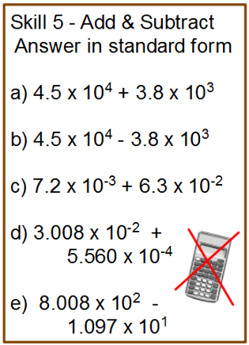
4.88 x 10⁴
4.12 x 10⁴
7.02 x 10⁻²
3.0636 x 10⁻²
7.8983 x 10²

Slide 17
Multiply & divide NON - Calculator

Slide 18
6 x 10⁷
1 x 10⁷
3 x 10⁴
3 x 10⁻⁴
8 x 10⁻⁸
4 x 10³
2.43 x 10¹
4 x 10⁷

Slide 19
Standard form Calculator Shift > setup > 7 (sci Mode)

Slide 20
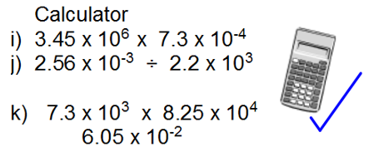
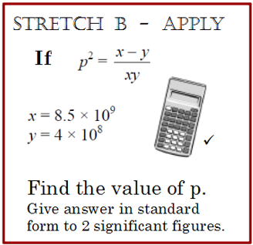
2.5185 x 10³
1.16 x 10⁻⁶ (3sf)
9.95 x 10⁹ (3sf)
P = 4.9 x 10⁻⁵ (2sf)

Slide 21
Standard Form by K Islania (2017) of English Martyrs’ Catholic School. This work is licensed under a Creative Commons Attribution 4.0 International License.

